Slide 1
Native American Heritage
Melissa Miller
Welcome Everyone!

Slide 2
Why am I teaching you about Native Americans?
Most of you have learned about Native Americans already
E.g. Thanksgiving, Pocahontas
My maternal grandmother was part Native American (Tribe name: Abenaki)
Native Americans are an important part of our history
Native Americans are suffering from Environmental Racism
Native Americans should be recognized
Native Americans do live among us
There are many USA citizens that are descended from Native American hertiage

Slide 3
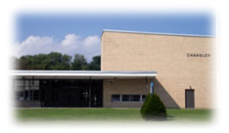
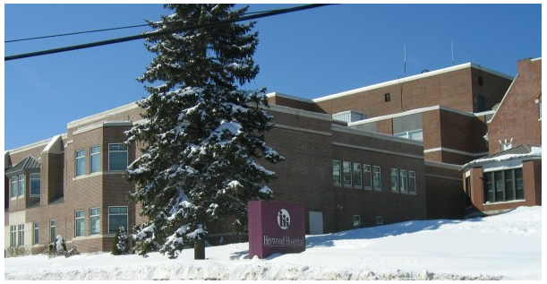
A Brief Story of my Grandmother
Born in December 1st or 7th 1922
Had to leave family and was adopted
Tough life
Hard-working, smart woman especially in terms of the stock market
Caring person, very talented in arts and crafts
Elementary School teacher at Chandler Magnet Elementary
Nurse
Died in 1996 (Memorial Day)
http://boards.ancestry.com/surnames.lashua/1.9.11.1.1.1.1.1/mb.ashx

Slide 4
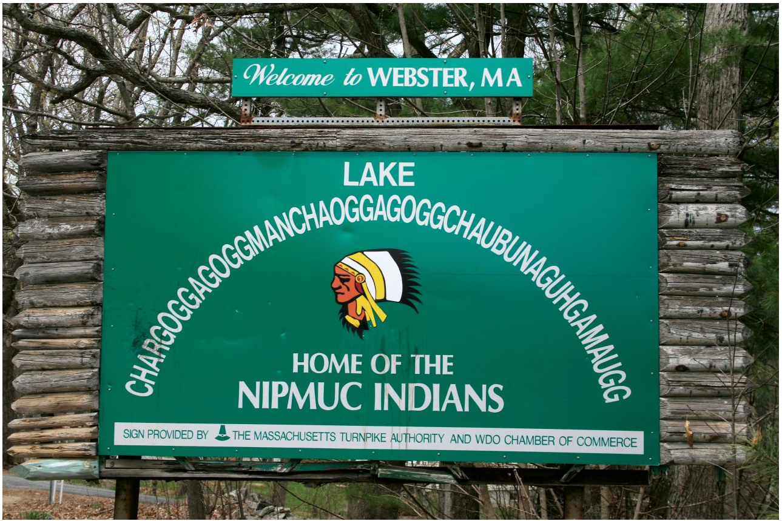
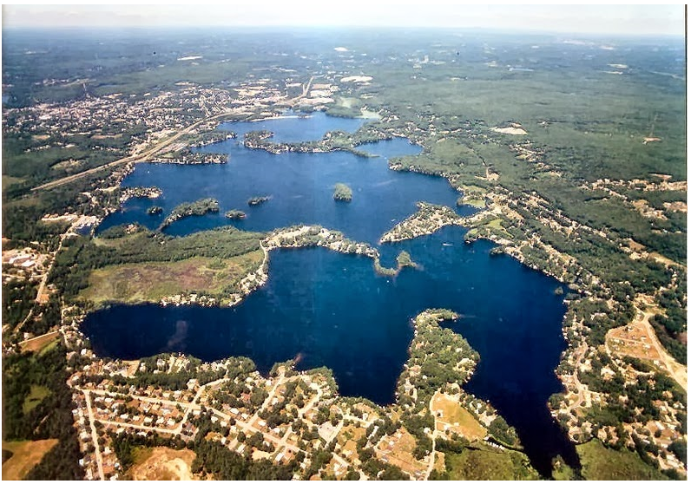
Visit Cultural museums and Reservations
Chaubunagungamaug (which in the Nipmuc language is said to mean Fishing Place at the Boundaries --- Neutral Meeting Grounds)

Slide 5
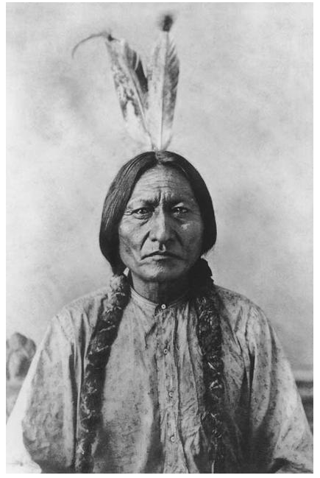
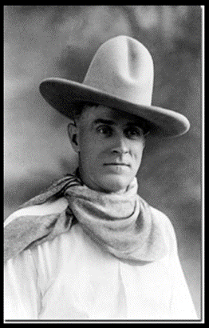
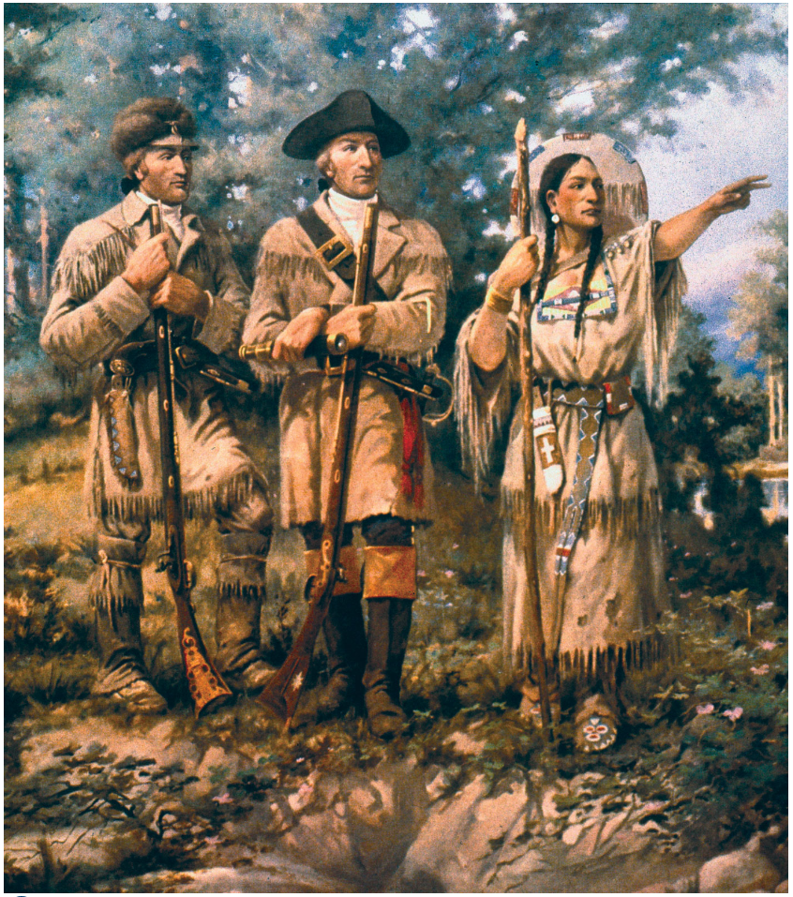
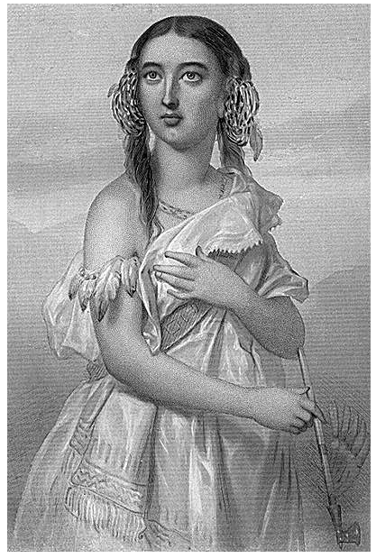
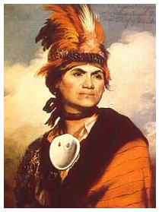
Famous Native Americans

Slide 6
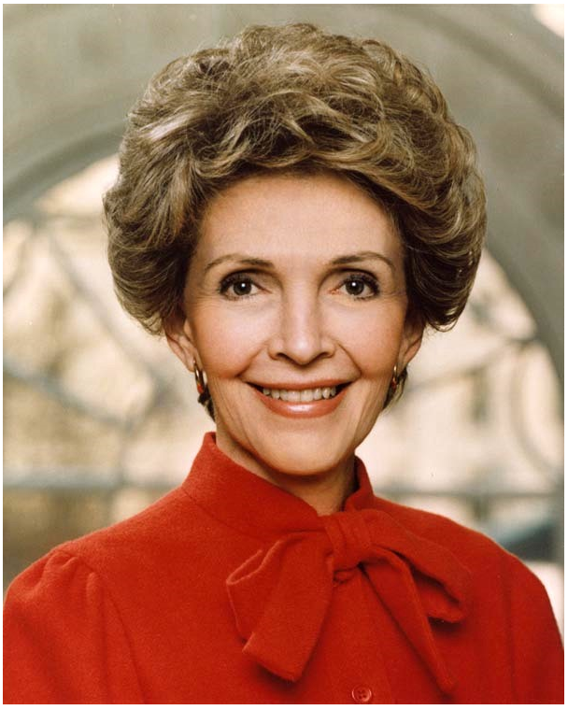
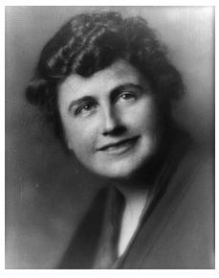
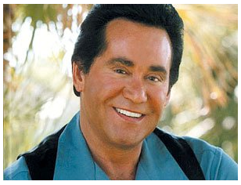

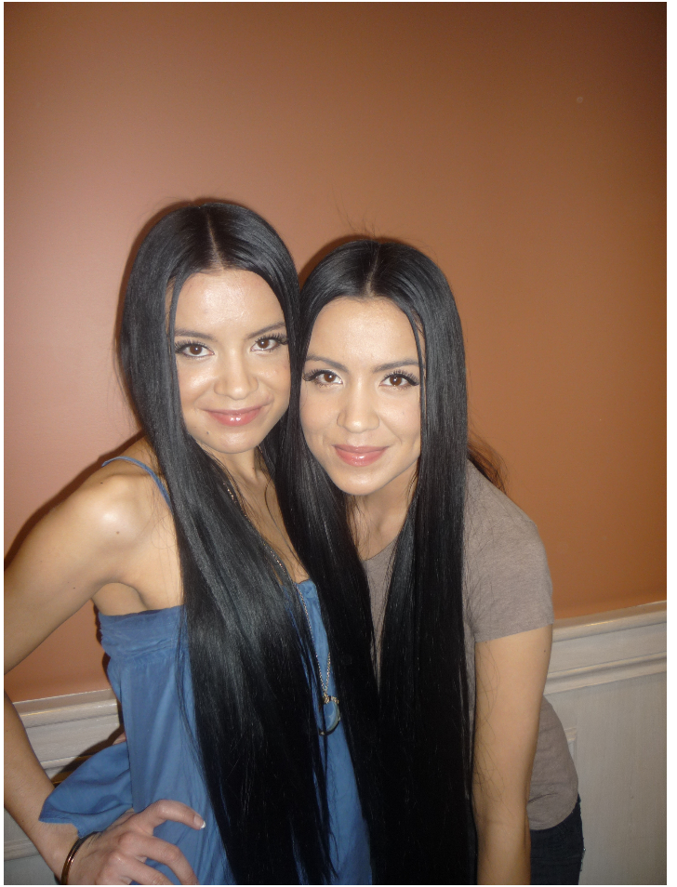
Famous People Today who are Descendants

Slide 7
List of some Tribes
There are many names, but to name a few
Blackfoot (Blackfeet)
Apalachee, Nez Perce (Nimiipuu)
Cree, Lakota, Creek
Dakota, Eskimo, Hawaiian Natives
Fox, Inupiut, Iroquois, Cheorkee
Powhatan, Quileute, Rumsen, Sac
Sooke, Wampanoag, Wea
Yuchi (Yuchee), Zia, Zoque

Slide 8
Traditions
Many of the tribes are very spiritual, in touch with nature
Spiritual Journey
Shaman
They made arrowheads that they used for hunting
Dream Catchers
Jewelry
War Painting
Musical Instruments
Many Native Americans had spiritual dances like the Ghost Dance (natdia)

Slide 9
Spirtual Journey
Many reasons: a rite of passage ceremony called a Vision Quest, help and guidance from the spirit world, spiritual healing, inner exploration, personal growth and direction along the path of life
Undertaken by a Shaman who can sometime undergo a Trance State for the purpose of attaining guidance or knowledge from supernatural forces or spirits.
Natural Herbal Herbs and plants are used induce the trance state
Examples include Mescal, peyote cactus, thorn apple, psilocybin mushroom, green tobacco, jimsonweed, and devil’s weed.
It is envisioned by a Shaman as a route to the Spirit world

Slide 10
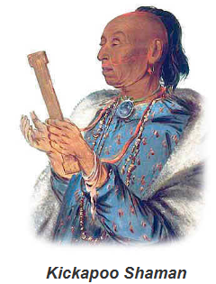
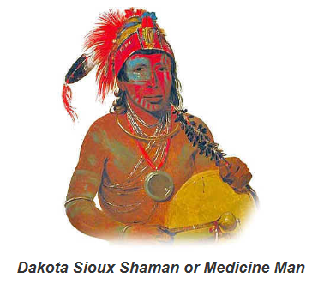
Shaman
A spiritual leader of a group or tribe
Responsible for a range of beliefs, customs, ceremonies and rituals in regards to communicating with the spiritual world
A doctrine based on a belief that physical nature might be brought under the control of man, in the person of a Shaman
Role: using appropritate words, objects and rituals to protect men from evil spirits
Battles opponents to the bad spirits and of guardian to the ordinary man
Every object in nature is controlled by its own independent spirit or soul
Used to heal people with bad spirits

Slide 11
Arrowheads
Tip, usually sharpened, added to an arrow
Tip is used to make the arrowhead more deadly, or to fulfill some special purpose
Earliest: made out of stone and of organic material
Arrowheads are attached to arrow shafts to be shot from a bow
Native Americans hunt with Arrowheads and also use bow and arrows

Slide 12
Dream Catchers
The traditional dream catcher was intended to protect the sleeping individual from negative dreams, while letting positive dreams through
Positive dreams would slip through the hole in the center of the dream catcher, and glide down the feathers to the sleeping person
Negative dreams would get caught in the web and expire when the first rays of the sun struck them
Dream Catchers relate to the tradition of the hoop which is held in highest esteem, because it symbolizes strength and unity
It is part of the Ojibwe and Lakota Culture
Made with a hoop of willow, feathers, arrow heads, beads
I have a few dream catchers and one that I made myself

Slide 13
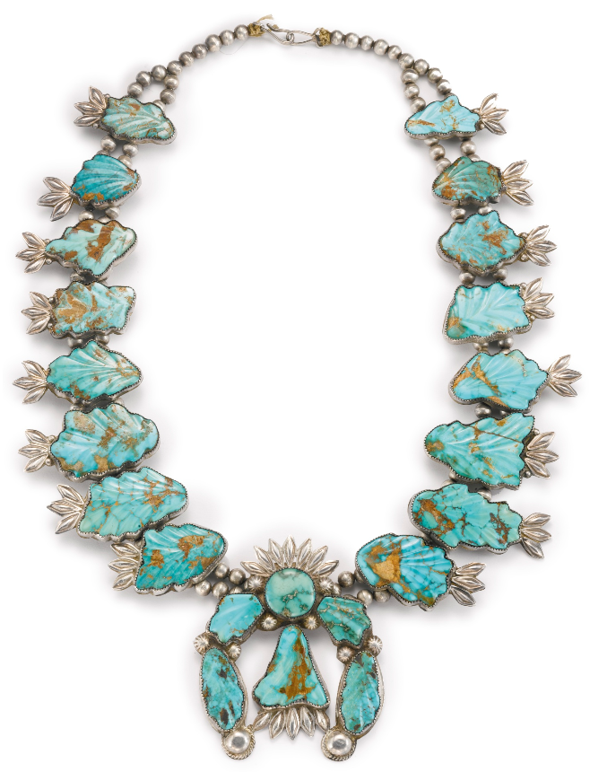
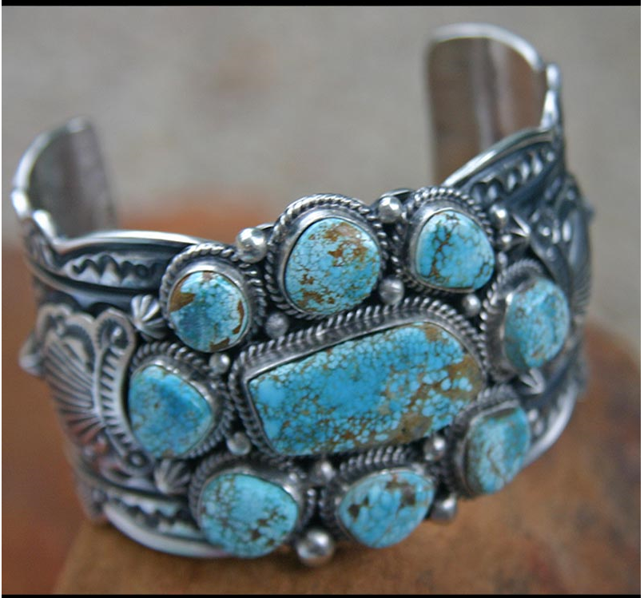
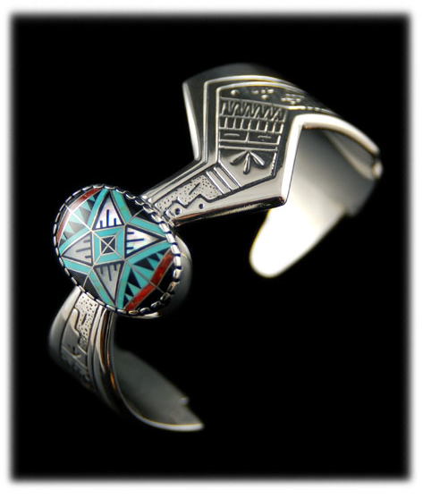
Jewelry

Slide 14
War painting
Native American men did this practice
A part of the complex warrior culture, especially the tribes that lived on the Great Plains
Experienced warriors were shown to have the highest esteem, and their achievements of warriors were reflected (most of the time) in symbolic images of war paint
Clothes, tepees, and all of their belongings were decorated with symbolism of their achievements and acts of heroism or his various spirit guides
Every mark on the face and body of a Native American had a meaning
War painting was particularly used in the Akicita of the Lakota Sioux tribe

Slide 15
Examples of War Paint
Each war paint and insignia of an Akicita had specific meanings of their roles and responsibilities
1. Marshall of a war party would have war paint depicting two black stripes on the right check.
2. Marshall of an Indian camp had a black stripe painted on the right check from the corner of the eye to the jaw line
3. Ceremonial marshal who organizes Pow-Wows and large council meetings had a red parallel stripe.
4. Hand symbol indicates that the warrior has been successful in hand-to-hand combat

Slide 16
Musical Instruments
Gender plays an important role in Native American music
Ceremonial Drums are used during large tribal gatherings or celebrations and can be played by one individual or more
Jawbone Rattle is made out of the jawbone of a large dead animal (deer, elk, moose, buffalo) and after marble is dried pebbles are placed into the empty cavity and the hole is sealed
Medicine rattles are used by shaman to drive evil spirits from a person that was ill, the person would recover once the evil spirit is departed
Apache Spirit flute was used to communicate with the spirits of nature and the dead. It was thought to bring peace to the spirits of the dead

Slide 17
Spiritual Dances
Ghost Dance (Natdia) is a spiritual movement that came about in the late 1880s when conditions were bad on Indian reservations and Native Americans needed to give them hope.
Grass Dance: the job is to flatten the grass in the arena before other important celebrations. It comes from the old habitat of tying braids of sweet grass to the dancer’s belts. It is traditionally a mens’ dance only. It is thought to have begun with the northern Plains Indians including the Omaha-Ponca and the Dakota Sioux.
Hoop dance: it is a storytelling dance which incorporates from 1-40 hoops to create both static and dynamic shapes. It is believed to have been a part of a healing ceremony designed to restore balance and harmony in the world. The hoop represents the never-ending circle of life.

Slide 18
Environmental Racism
Native American land has suffered from dumping of nuclear weapons testing, uranium mining
Uranium mining caused a huge incident in Wounded Knee in the 1970s. A movie was made based on this story called Thunderheart starting Val Kilmer (Val Kilmer is actually a Native American Activist)
Native Americans also suffer from radioactive waste dumping during the Nuclear Age in the 1950s
Inuits territories are used for oil and gas drilling
Treaties (were and still are consently being violated by the USA)
John Day River Dam impacted salmon spawning and rearing habitat, hunting salmon is a HUGE part of Native American culture

Slide 19
Native Americans in History
Pocahontas’s notable association with the colonial settlement at Jamestown, Virginia
Founding of Thanksgiving (Piligrims, Squanto (a Patuxet Native American) and Wampanoag tribe
Many Native American tribes were involved in both the French-Indian War and The American Revolutionary War.
Lewis and Clark’s Expedition was completed with the help of Sacagawea
President Andrew Jackson was responsible for the Trail of Tears that implemented the Indian Removal Act of 1830 which mandated the removal of most American Indian Tribes east of the Mississippi River to lands in the west (e.g. Oklahoma) killed hundreds of Cherokee
Forceful Assimilation into American society
Wounded Knee Massacre in December 29, 1890
Wounded Knee Incident from February 27 to May 8 1973

Slide 20
Celebrate Thanksgiving but not COLUMBUS DAY!
Reasons why
Columbus was responsible for the deaths of many Native Americans
The Lucayan Natives worked for hours to rescue Columbus’s Santa Maria ship
Columbus took 25 Lucayan Natives back to Spain, only seven survived the Voyage
The Natives showed Columbus kindess, but all he saw was weakness and wrote in his 1492 journal entry “I could conquer the whole of them with fifty men and govern them as I pleased”
Columbus told Queen of Spain about the “New World” he discovered, she gave him 17 ships, 1,500 men, and an arsenal of swords, crossbows, and cannons

Slide 21
Celebrating Thanksgiving but not Columbus Day
6. Columbus returned to the New World with weapons
7. Columbus demanded the Lucayan people to give his men food and gold, and allow them to forcefully harm their women
8. When the Lucayans refused, Columbus had their ears and noses cut off
9. A war began, and many of Lucayan Natives were killed
10. This is why we should not celebrate Columbus Day
11. Thanksgiving is a day that brings together the Native Americans and Piligrims who were trying to get along in peace
12. To have a wonderful meal and to be grateful for what you have

Slide 22
Cultural Assimilation of Native Americans
Lasted from 1887 to 1943
Reformed Indian administration and assimilate Indians as citizens
People who lived in close association with the natives called themselves “Friends of the Indians”
The call for change was taken up by Eastern reformers
Reformers were Protestants and Catholics from well organized denominations who considered assimilation necessary to the Christianizing of the Indians
In 1865, the USA government made contracts with various missionary societies to operate Indian schools for teaching citizenships, English, aricultural methods and mechanical arts

Slide 23
Native Americans In media
Disney’s Peter Pan and Pocahontas (Sequel: Pocahontas 2: Journey to a New World), Brother Bear and Brother Bear 2
Liberty’s Kids (Computer CD-rom game)
The Lone Ranger (TV show and Movie)
The Baker Twins were actresses on the show Smallville
Caddie Woodlawn (Book and Movie)
Coyote Summer
Spirit Rider
Wind Runner (Margot Kidder)
American Girl (Kaya)
Nancy Drew (The Secret of Shadow Ranch (1965 revision and Computer Game) Character is named Mary Yazzie
Twilight (Jacob Black and his Native American Reservation (still a bad movie series))

Slide 24
Videos
https://www.youtube.com/watch?v=Z79eFWt-pbg
https://www.youtube.com/watch?v=_dqHMbl9j3E
https://www.youtube.com/watch?v=mR-tbOxlhvE
https://www.youtube.com/watch?v=ytsHHxGySpg
https://www.youtube.com/watch?v=idlbAbuUHjg
https://www.youtube.com/watch?v=8VPOoSw4aeI
https://www.youtube.com/watch?v=bzck-_MROrI

Slide 25
How to Get Invovled
AIM (American Indian Movement) (http://www.aimovement.org/)
Native American Heritage Association (https://www.naha-inc.org/)
National Relief Charities (http://www.nrcprograms.org/site/PageServer?pagename=index)
St. Labre Indian School (http://www.stlabre.org/)
Leave your Mark in the USA (http://www.globalvolunteers.org/usa/)
Create petitions
Visit a Native American Tribe
Create a club that involved Native American Awareness
Bring this to the attention of Politicians
Join Native American Advocay (Socialist groups)
Preservation of Old Languages from the Native American Tribes (A huge majority of them are fading due to small population sizes)

Slide 26
Any Questions or comments?
Thank you all for attending this class!

